Slide 1
Safaricom Digital Academy Data Science GIS Assignments
submitted by
by
Barbara Akelo osiro

Slide 2
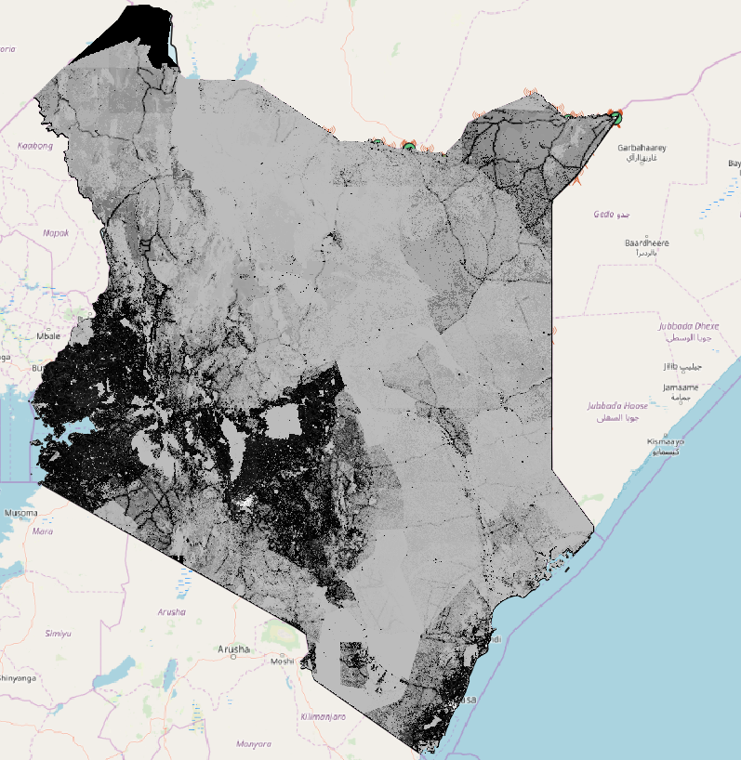
A screen shot of raster population layer

Slide 3
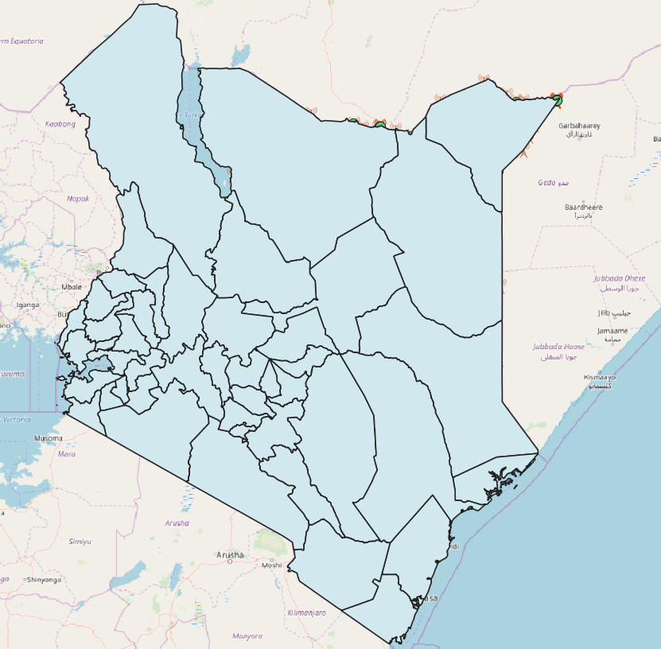
A screen shot of County Layer

Slide 4
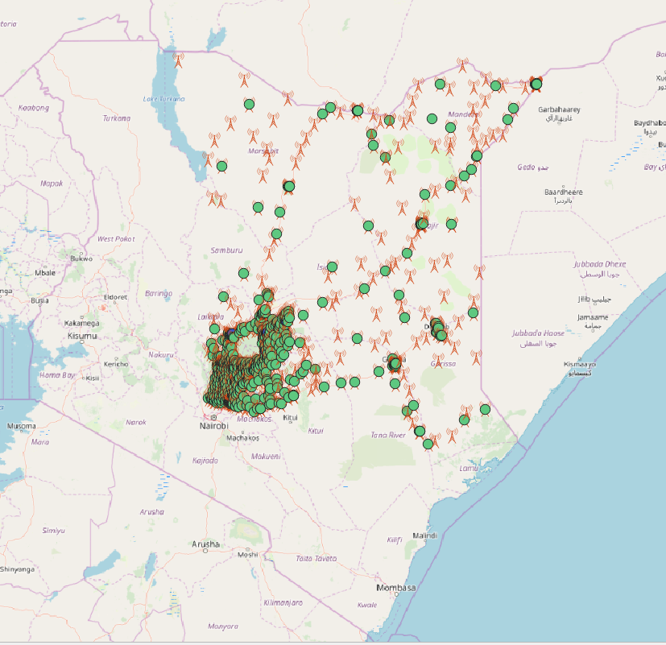
A screen shot of street map layer

Slide 5
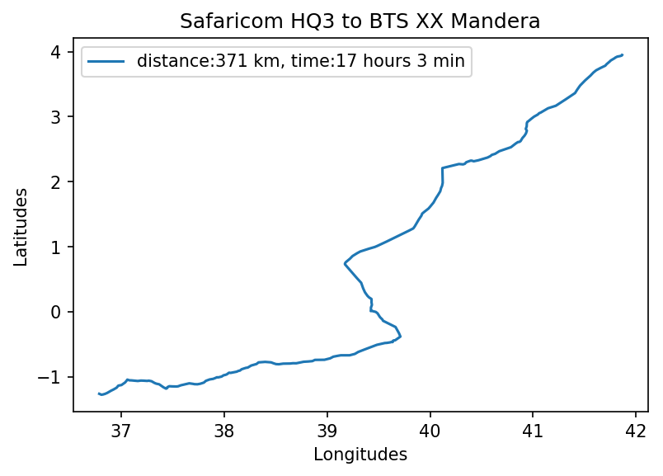
Saf HQ3 to Mandera one way trip pic 1

Slide 6
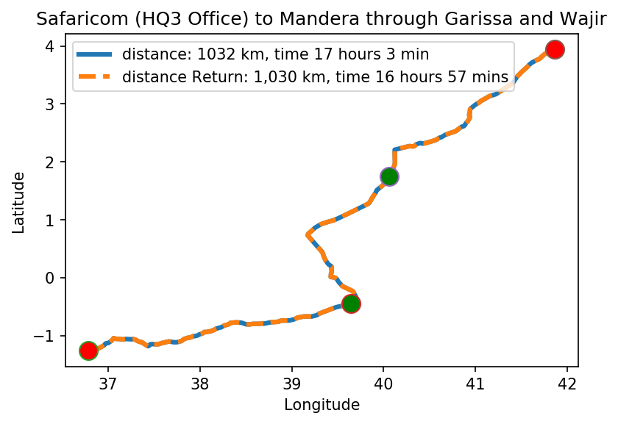
Saf HQ3 to Mandera return trip pic 2

Slide 7
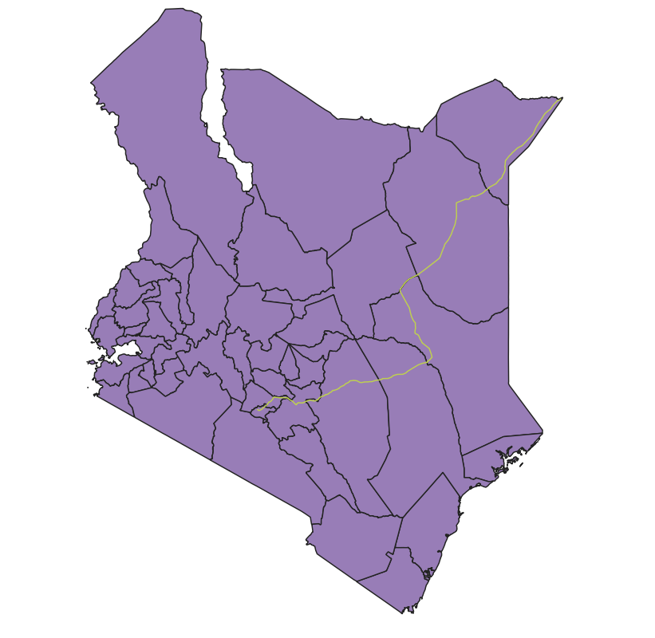
Saf HQ3 to Mandera return trip against the county layer

Slide 8
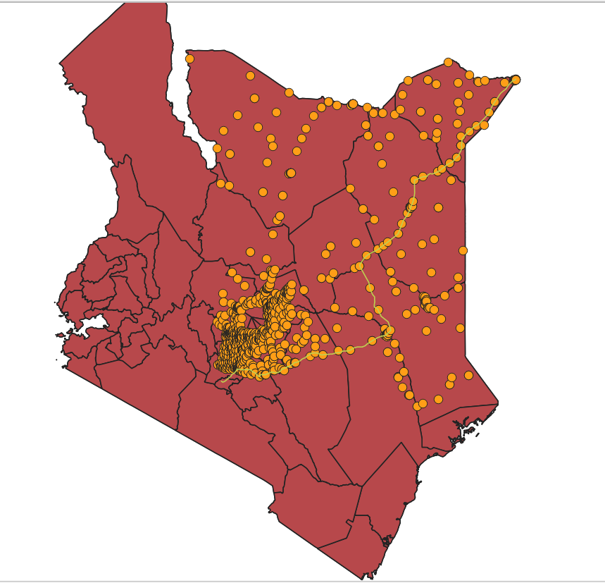
Saf HQ3 to Mandera return trip against the BTS layer

Slide 9
COST SAVING STRATEGIES
Cheaper vehicles
Maximize on available time
Source for cheaper accommodation
Employ team work and work with colleagues stationed at this points to reduce travel costs

Slide 10
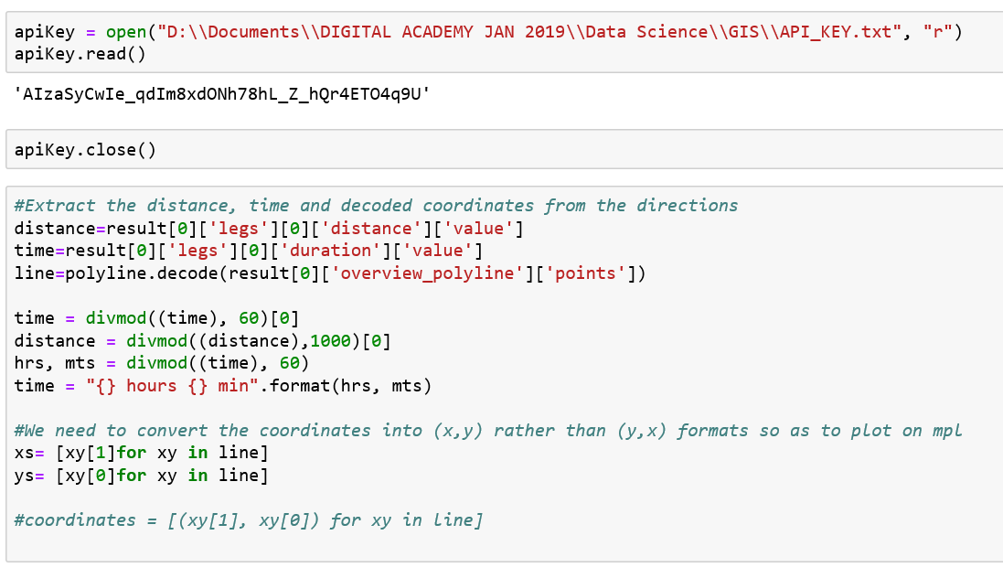

Slide 11
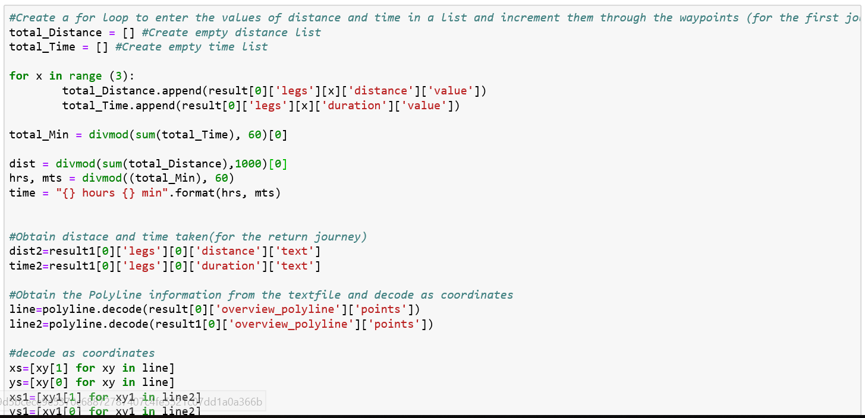

Slide 12
#Setting out the various per unit costs
'Total_hours | 34hrs 0min'
'Total_distance | 2062kms'
'Absolute Rules:15 min break after every 2 hours, driving is between 5am and 10pm | 17 hours per day 2 hours of rest
34 hours to cover in 15 hours per day | 2.26 days approximately 3 days
'Mileage allowance (Ksh.30 / km) by Total distance 'Total per diem rate of 8,000/ = per night for 3 days/2 nights | 2062kms= Ksh.61,860', Ksh.16,000',
'Accommodation of 7,000/ = per night for 3 days/2 nights = | Ksh.14,000',
'Total Fuel consumption Total distance = 2062kms*(0.1Litres/km)=206.2Litres (fuel is Ksh.98/ l) | Ksh.20207.60

Slide 13
#Setting out the various overall journey costs
'Mileage allowance as per AA rates for Kenya FY2018 (Ksh.30 / km)', | Ksh.30 / km
'Fuel consumption per km. Assume the company only uses long chase Land cruisers | 10Litres/100 km
'Accommodation of not more than 7,000/ = per night', | 7,000/ = per night
'Standard per diem rate of 8,000/ = per night') | 8,000/ = per night

Slide 14
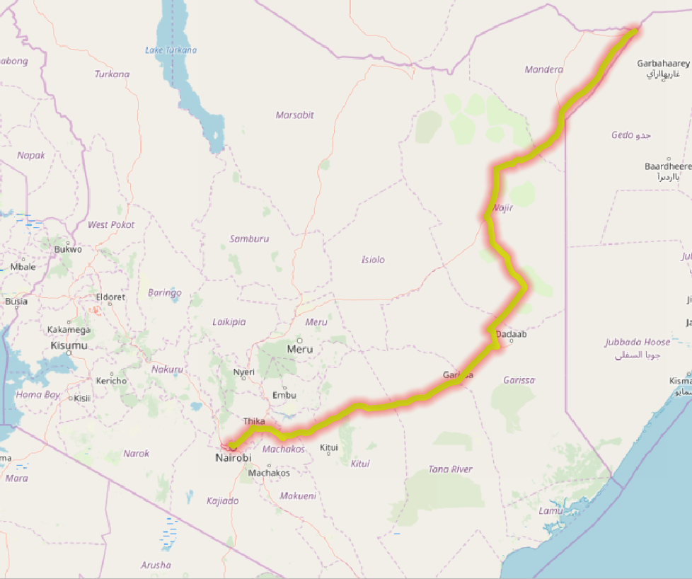

Slide 15
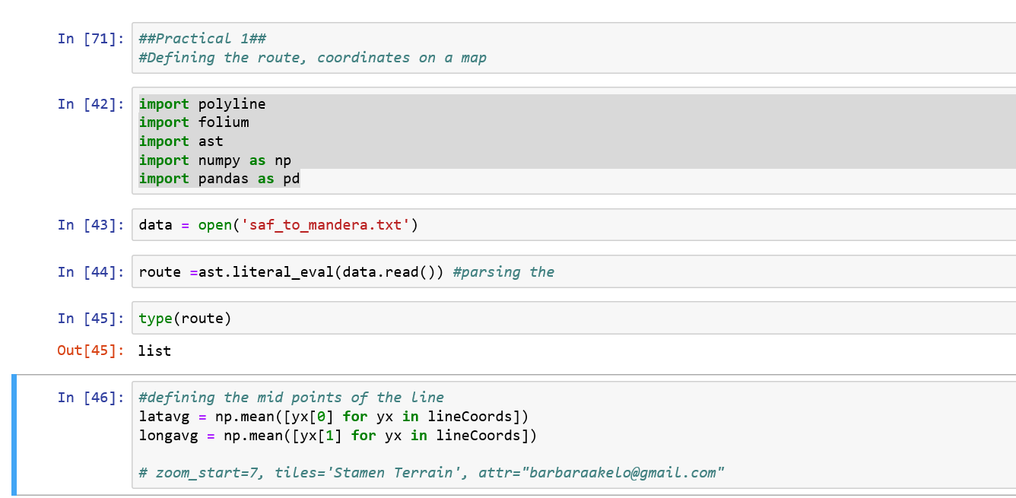

Slide 16
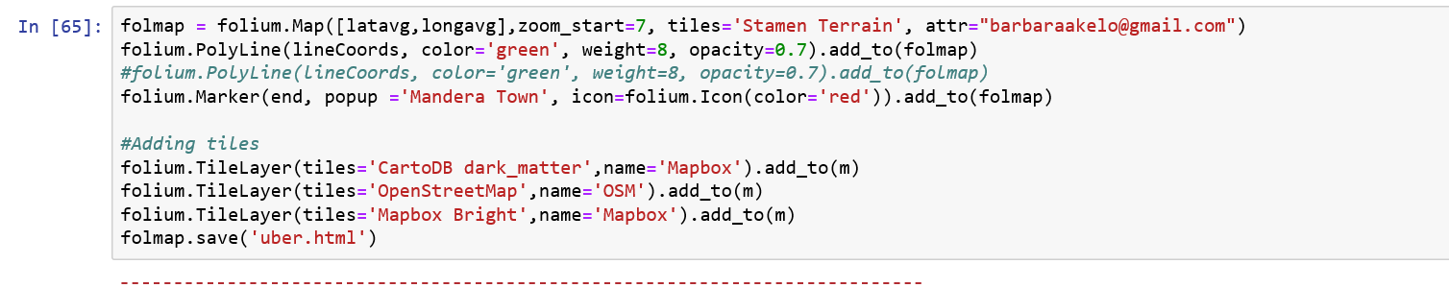

Slide 17
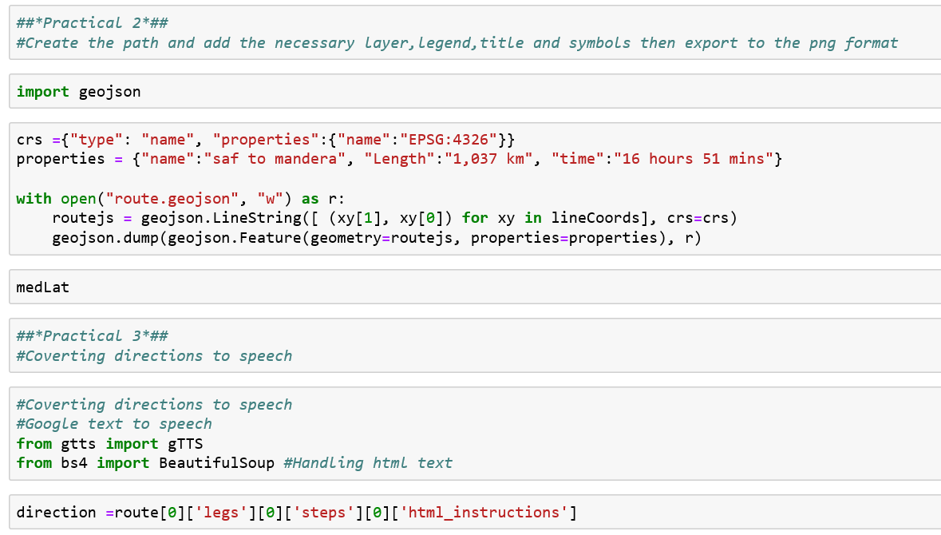

Slide 18
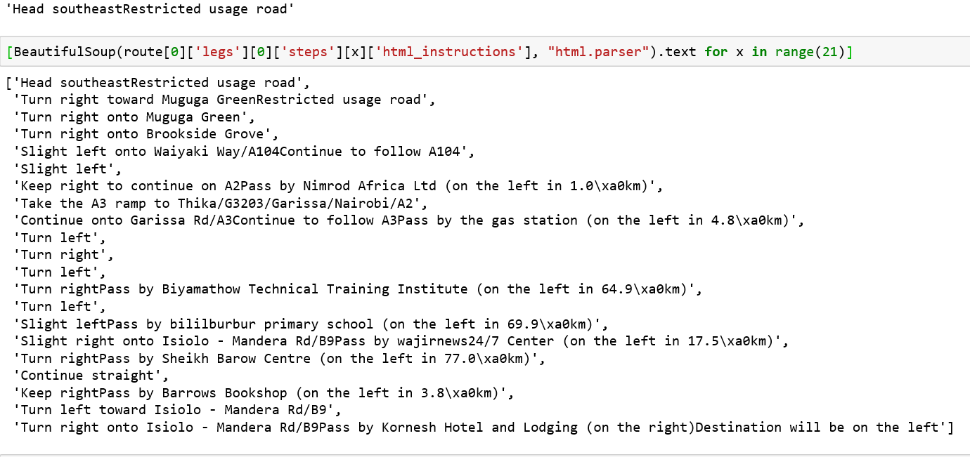

Slide 19
https://github.com/Bosiro/GIS-Exercise

